Slide 1
REST API
Fundamentals
learn more

Slide 2
Why API Automation is growing in demand?
API Based Apps
Faster
Easier & Isolated
Data Generation
Less Failures
01
02
03
04
05

Slide 3
Why API Automation is growing in demand?
API Based Apps
01

Slide 4
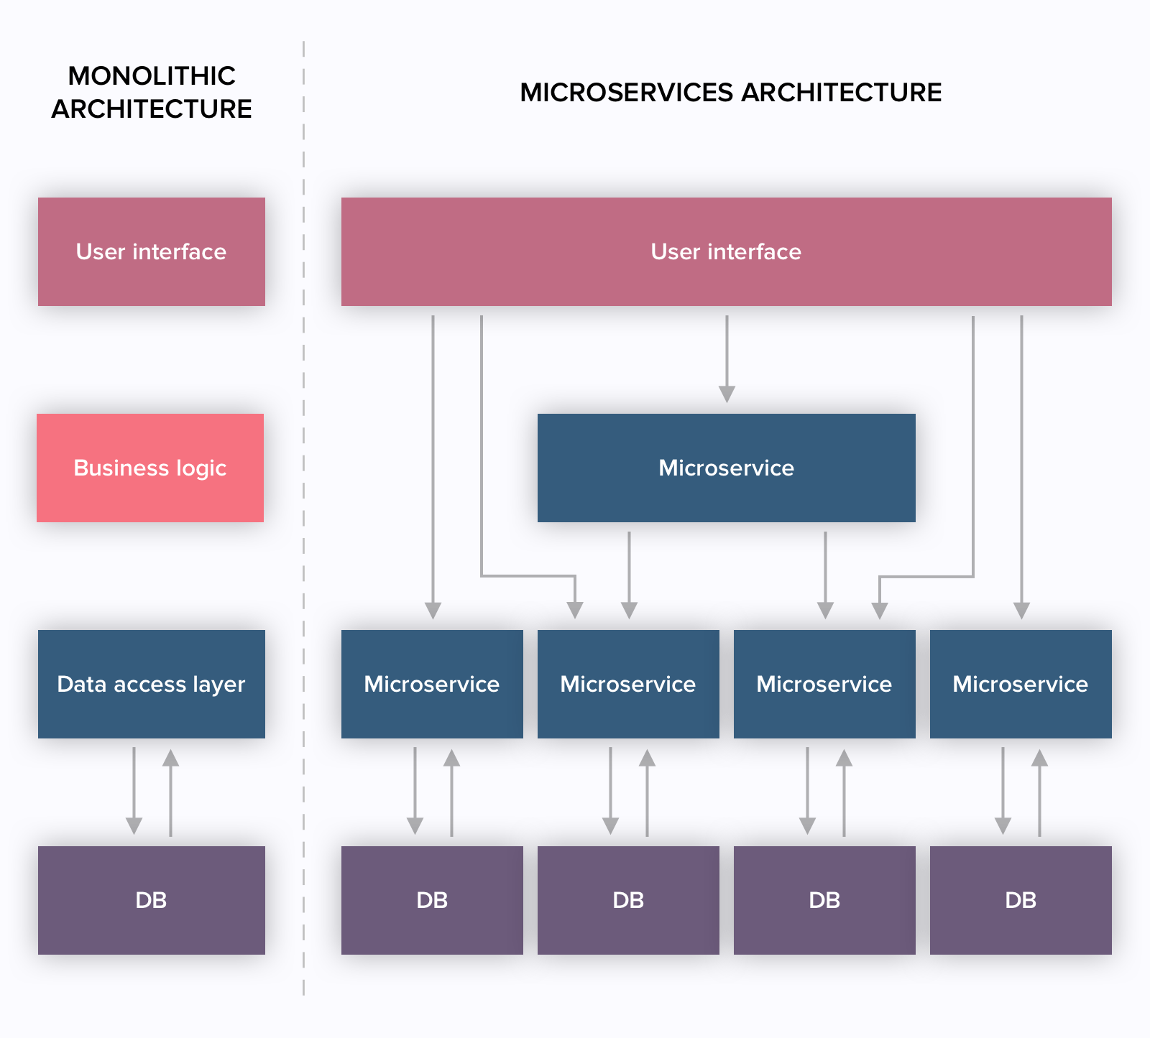
API First Design Strategy – Leading Italian Bank

Slide 5
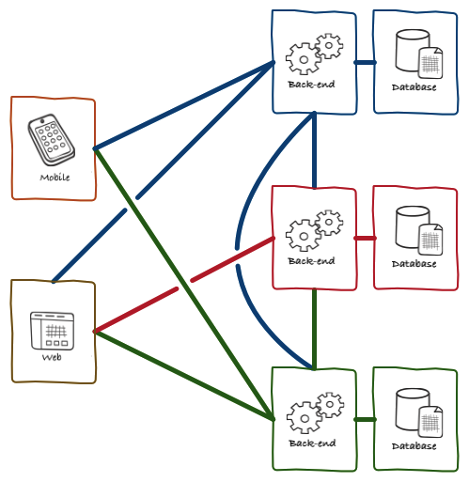
API First Design Strategy – Leading Italian Bank

Slide 6
Why API Automation is growing in demand?
Faster
02

Slide 7

Rendering Engine

Slide 8
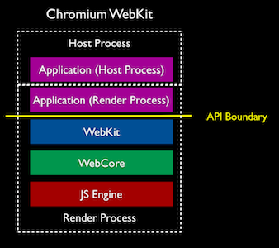
Rendering Engine

Slide 9
Why API Automation is growing in demand?
Easier & Isolated
03

Slide 10

Browser Specific

Slide 11
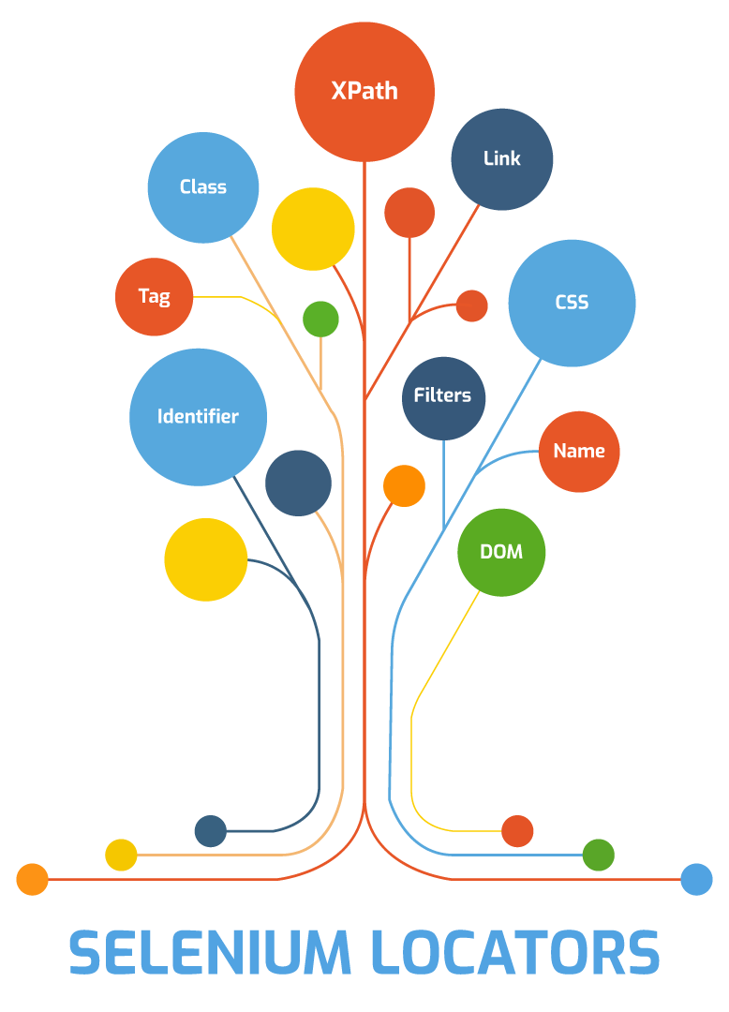
Element Challenges

Slide 12
Why API Automation is growing in demand?
Data Generation
04

Slide 13
Why API Automation is growing in demand?
Less Failures
05

Slide 14

Element Not Found Challenges

Slide 15
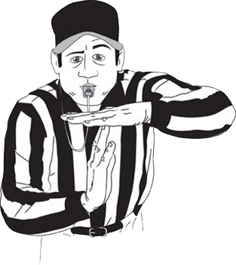
Time Out (Behavioral) Failures

Slide 16
Summary !!
API Based Apps
Faster
Easier & Isolated
Data Generation
Less Failures
01
02
03
04
05

Slide 17
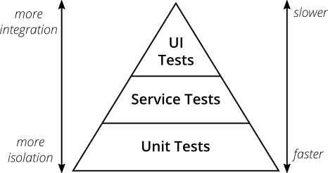
Mike Cohn’ Test Pyramid

Slide 18
Test Pyramid - Take Away
Write tests with different granularity (End to End tests in UI)
2. The more high-level you get the fewer tests you should have

Slide 19
SOAP vs REST vs GraphQL vs gRPC
SOAP - Simple Object Access Protocol (1998)
REST - Representational State Transfer (2000)
GraphQL – Graphical Query Language (2015)
gRPC – Google Remote Procedural Call (2016)

Slide 20
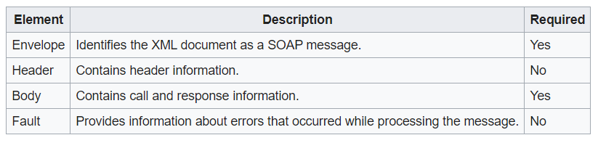
SOAP
1998
SOAP (Simple Object Access Protocol) is a messaging protocol specification for exchanging structured information in the implementation of Web Services.
XML
GET, POST
Higher Payload
No Cache

Slide 21
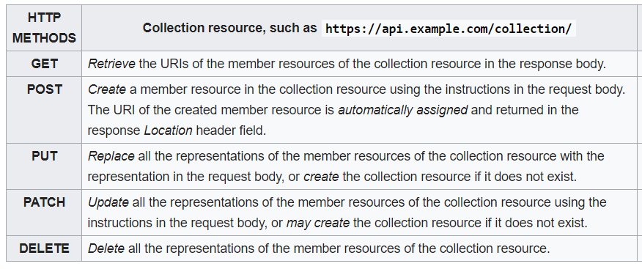
REST
2000
Representational state transfer (REST) is a software architectural style that defines a set of constraints to be used for creating Web Services
XML, JSON, TXT, HTML
GET, POST, DELETE
PUT, PATCH, HEAD ..
Lower Payload
Stateless, Cache

Slide 22
GraphQL
2015
GraphQL is an open-source data query and manipulation language for APIs, and a runtime for fulfilling queries with existing data
JSON
Asynchronous
HTTP, AMQP, MQTT
Send Only required data

Slide 23
GraphQL request and response
{
"data": {
"user": {
"name": "John Doe",
"email": "john@example.com"
}
}
}
query {
user(id: "123") {
name
email
}
}

Slide 24
gRPC
2016
A nimble and lightweight system for requesting data. gRPC, on the other hand, is best used when a system requires a set amount of data or processing routinely
Proto
Asynchronous
Highly Scalable
service UserService {
rpc GetUser (UserRequest) returns (UserResponse);
}
Server Communication

Slide 25
Real World Use-cases
🌐 REST API: Best for Web & Mobile Apps
Examples: Twitter, Spotify, Uber, Stripe, OpenWeather
🔒 SOAP API: Best for Secure Enterprise Apps
Examples: PayPal, Banking (Visa, SWIFT), Healthcare (EMR, HL7)
⚡ gRPC API: Best for Microservices & IoT
Examples: Netflix, Google Cloud, Slack, Tesla, Smart Homes
🎯 GraphQL API: Best for Flexible Data Fetching
Examples: Facebook, GitHub, Shopify, Twitch, HackerRank

Slide 26
HTTP Methods (CRUD)
1
2
3
4
5
GET
POST
DELETE
PUT
PATCH
Retrieve resource information
(READ)
Create new subordinate resources
(CREATE)
delete resources
(DELETE)
primarily to update existing resource
(REPLACE)
make partial update on a resource
(UPDATE)

Slide 27

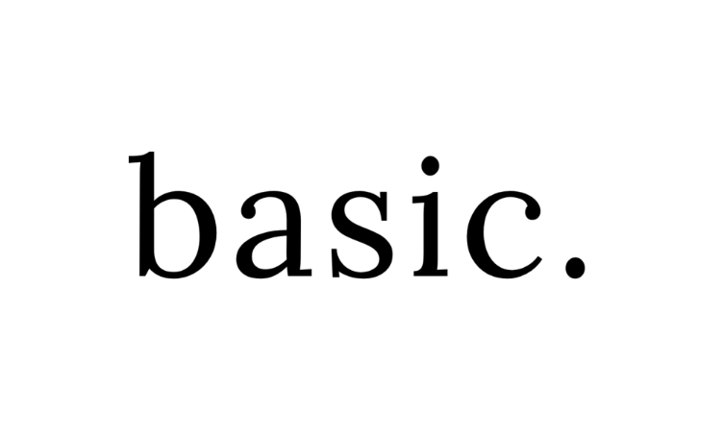

Authentication
No Authentication
Basic
OAuth 2.0
Token
Examples: Weather Forecast, Google Map
Examples: ServiceNow,
JIRA
Examples: Payment Gateways, ServiceNow
Examples: Oracle WMS,
JWT

Slide 28
HTTP Headers
Content-Type
Accept
Cookie
The Content-Type entity-header field indicates the media type of the entity-body sent to the recipient. (request)
The Accept request-header field can be used to specify certain media types which are acceptable for the response.
The Cookie request-header field value contains a name/value pair of information stored for that URL

Slide 29

Documentation Tool
https://covid-19-apis.postman.com/

Slide 30
Request Parameters
Header
Request header, usually related to authorization.
Query
Parameters in the query string of the endpoint, after the ?.
Form
Parameters included in the request body. Usually submitted as JSON.
Path
Parameters within the path of the endpoint, before the query string (?). These are usually set off within curly braces.

Slide 31
Request Parameters – Data Types
These data types are the most common with REST APIs:
string: An alphanumeric sequence of letters and/or numbers
integer: A whole number — can be positive or negative
boolean: true or false value
object: Key-value pairs in JSON format
array: A list of values
Header
Query
Form
Path

Slide 32
Request Body (Data Formats)
Form Data
Form (URL Encoded)
Form Data
Form
(URL Encoded)
In Key-value format (Text / File) including multi-part
Data is encoded in key-value format
None
Body
Contents
Raw Data
No
Contents
Raw
(JSON/XML)
No data passed in body
This can be JSON/ XML or TXT
Queries & Variables
Binary
Queries
(GraphQL)
Binary
Content
This is specially for the GraphQL Scenarios
The files or executables that can be attached

Slide 33
Body (Contents)
The body can have different formats like below:
JSON
01
JSON - JavaScript Object Notation
XML - Extensible Markup Language
TXT – Plain text format
TXT
XML
03
02

Slide 34
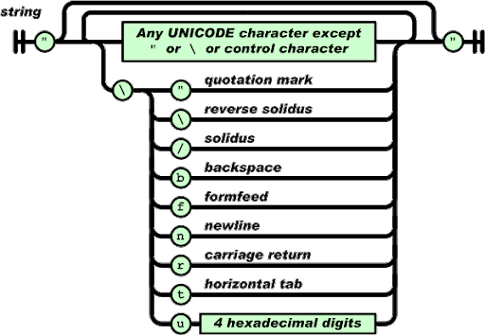
JSON – A quick run through
JavaScript Object Notation
Lightweight
Easy to understand
Not specific to languages

Slide 35
JSON Structure
Simple JSON format
Simple JSON Array
{
“name”: "Babu",
“age”: 45,
“city”: "Chennai"
}
{
“name”: "Babu",
“age”: 45,
“companies”: ["Syntel", "HCL", "HP", "TL"]
}

Slide 36
JSON Nested Arrays
{
"name":"Babu",
"age":45,
"companies":[
{"name" : "syntel", "years" : "3.1", "customers" : 4, "country" : ["india", "usa"]},
{"name" : "hcl", "years" : "1", "customers" : 1, "country" : ["india"]},
{"name" : "hp", "years" : "13.2", "customers" : 18, "country" : ["india", "usa","uk","sg"]},
{"name" : "tl", "years" : "4.3", "customers" : 8, "country" : ["india", "usa"]}
]
}

Slide 37
XML Structure
Simple XML
<?xml version="1.0" encoding="UTF-8"?>
<details>
<person>
<name>Babu</name>
<age>45</age>
<city>chennai</city>
</person>
</details>

Slide 38

Status Codes
100 -199
200 - 299
300 - 399
400 - 499
500 - 599
Information
Success
Redirects
Clients Errors
Server Errors

Slide 39
5 Step Process
Add Request
Headers + Authorization + Request Query / body
End Point
Send Request
Server + Port + Resources
Send to the server with the appropriate request type
03
STEP
02
STEP
04
STEP
Requirement
Validate Response
Swagger / PostMan Documentation
01
STEP
05
STEP
Verify with status code and body
START

Slide 40
Applications Under Test (AUT)
ServiceNow
ITSM Application
01
JIRA
Project Management Application
02
Salesforce
03
CRM Application

Slide 41
Thank You!

